Slide 1
Artificial Intelligence Experimentation Facility For the Energy seCTor
Presentation

Slide 2
NAME | STUDENT ID
ADITYA PATIL | 24251329
ANAND GOVINDRAJAN | 24251961
RAM KUMAR MALAIYAPPAN | 24250055
SATHWIK DHARANIKOTA | 24251187
SAURABH SAINDHANE | 24253166

Slide 3


The Project
The aim of this project is to use the AI4EXP platform to create an AI Pipeline that can be modular and easy-to-use.
Create documentation on the on-boarding process for the AI4EXP portal.
Understand the gRPC communication protocol to setup modules for AI4EXP portal.
Create a machine learning model to predict the energy consumption of a building.
Build docker images to containerize the developed model

Slide 4
Where we are ?
Develop the energy consumption prediction model
Document the On-boarding
process
On-boarding
Model

Slide 5
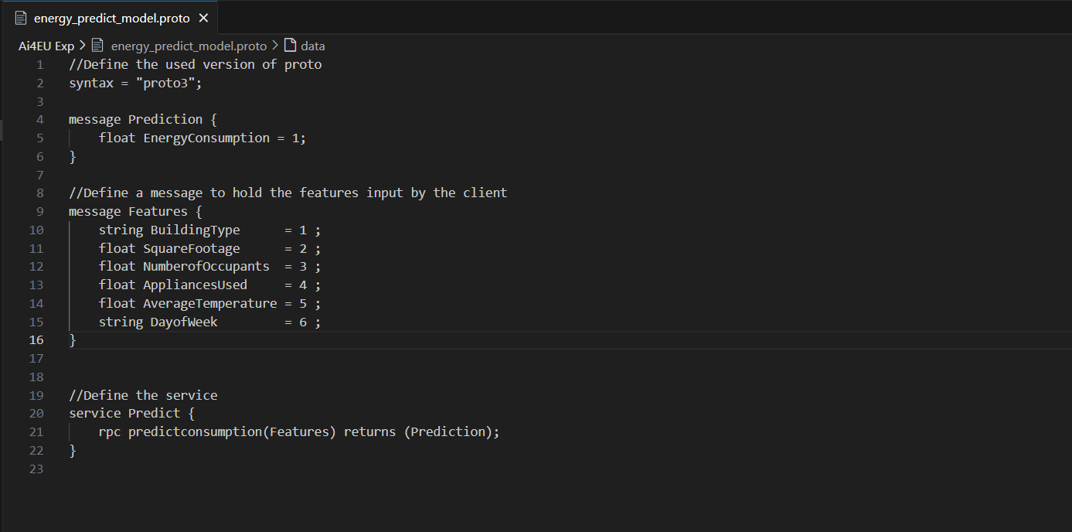
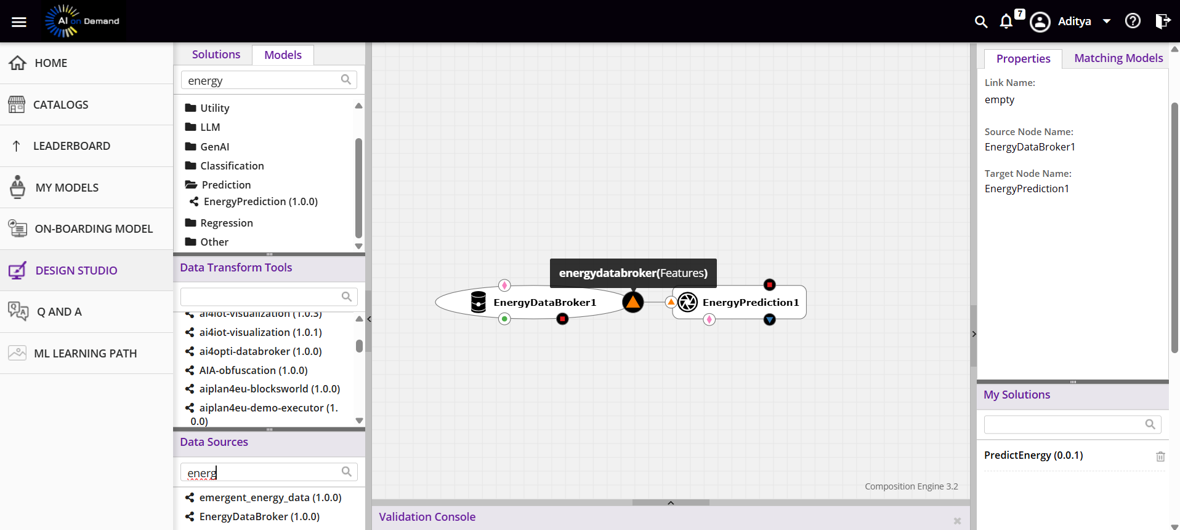
On-boarding Model
For on-boarding a model we need to create protobuf definitions of the gRPC services.
Once the protobuf definitions are created, we need to upload the .proto files to the AI4EXP portal.
The AI4EXP portal will make use of the .proto files and create the modules which can be used in the designer.
We will be then using these modules to create the pipeline for our AI model.

Slide 6
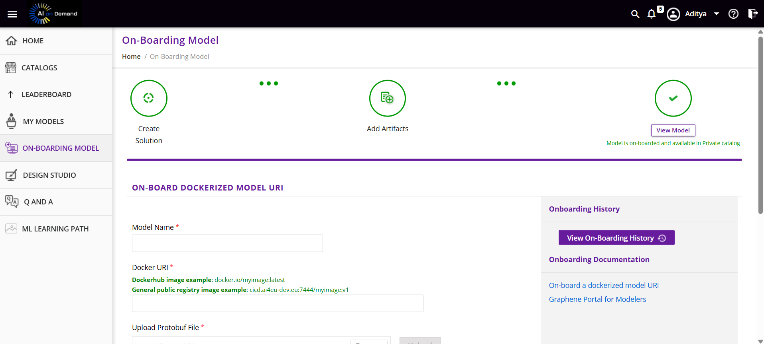
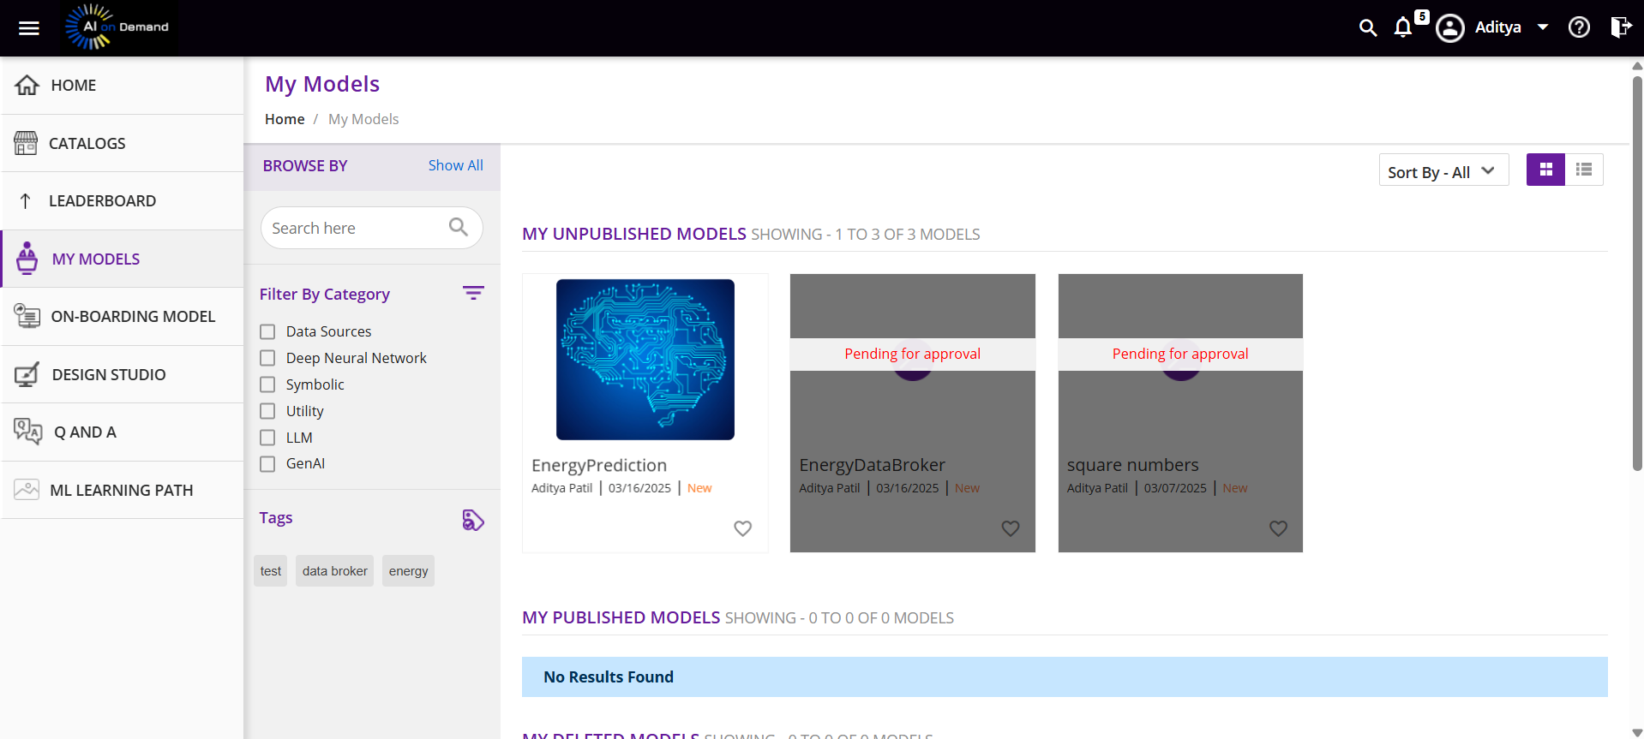
Documentation for On-boarding Model
Documented the steps for on-boarding the model.

Slide 7
Developing the Model
The Dataset
The dataset consists of 1000 records, containing the following variables: Building Type, Square Footage, Number of Occupants, Appliances Used, Average Temperature, Day of Week and Energy Consumption.
Building Type: Categorical feature representing the type of building.
Square Footage: Numeric feature representing the total square footage of the building.
Number of Occupants: Numeric feature indicating the number of people occupying the building
Appliances Used: Numeric feature representing the number of appliances used in the building.
Average Temperature: Numeric feature representing the avg temperature of the area (in Celsius).
Day of Week: Categorical feature representing whether the data corresponds to a weekday or weekend.
Energy Consumption: Numeric target variable representing the energy consumption of the building in kWh

Slide 8
Developing the Model
The Architecture
Databroker Service
Training Service
Prediction Service
Client Service

Slide 9
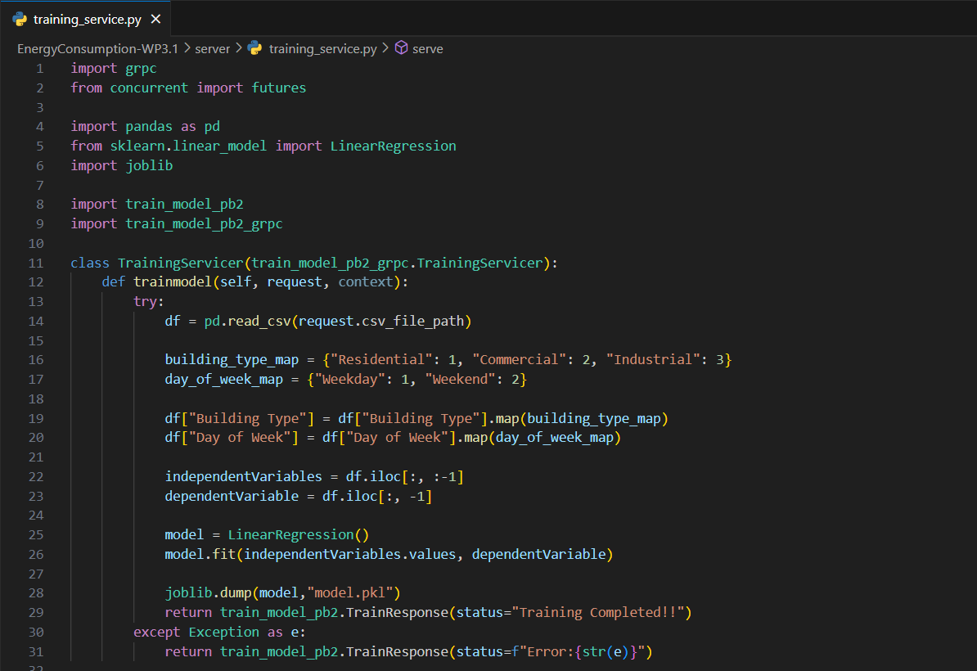
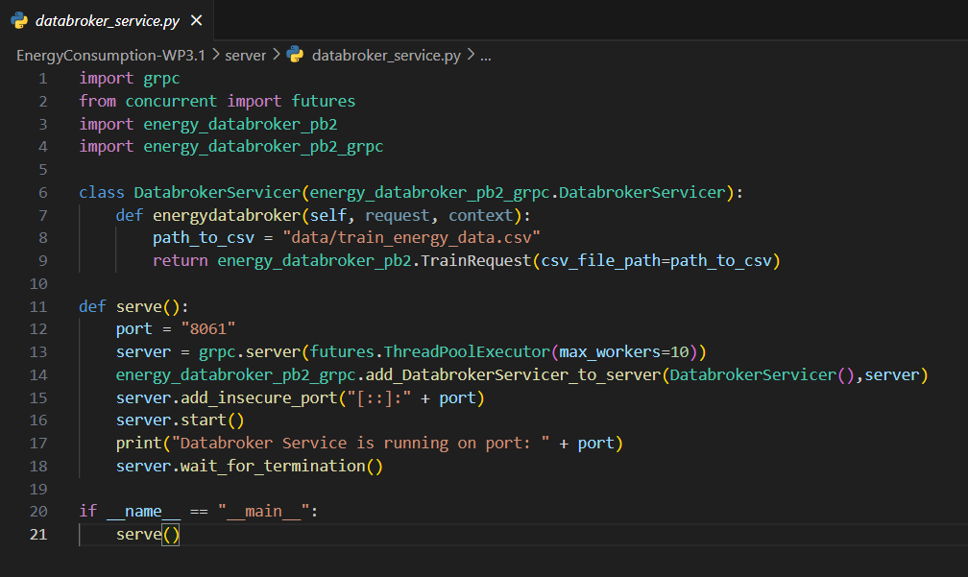
Developing the Model

Slide 10
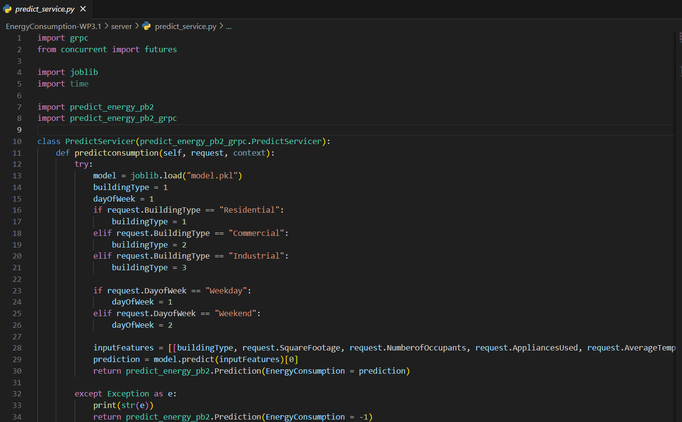
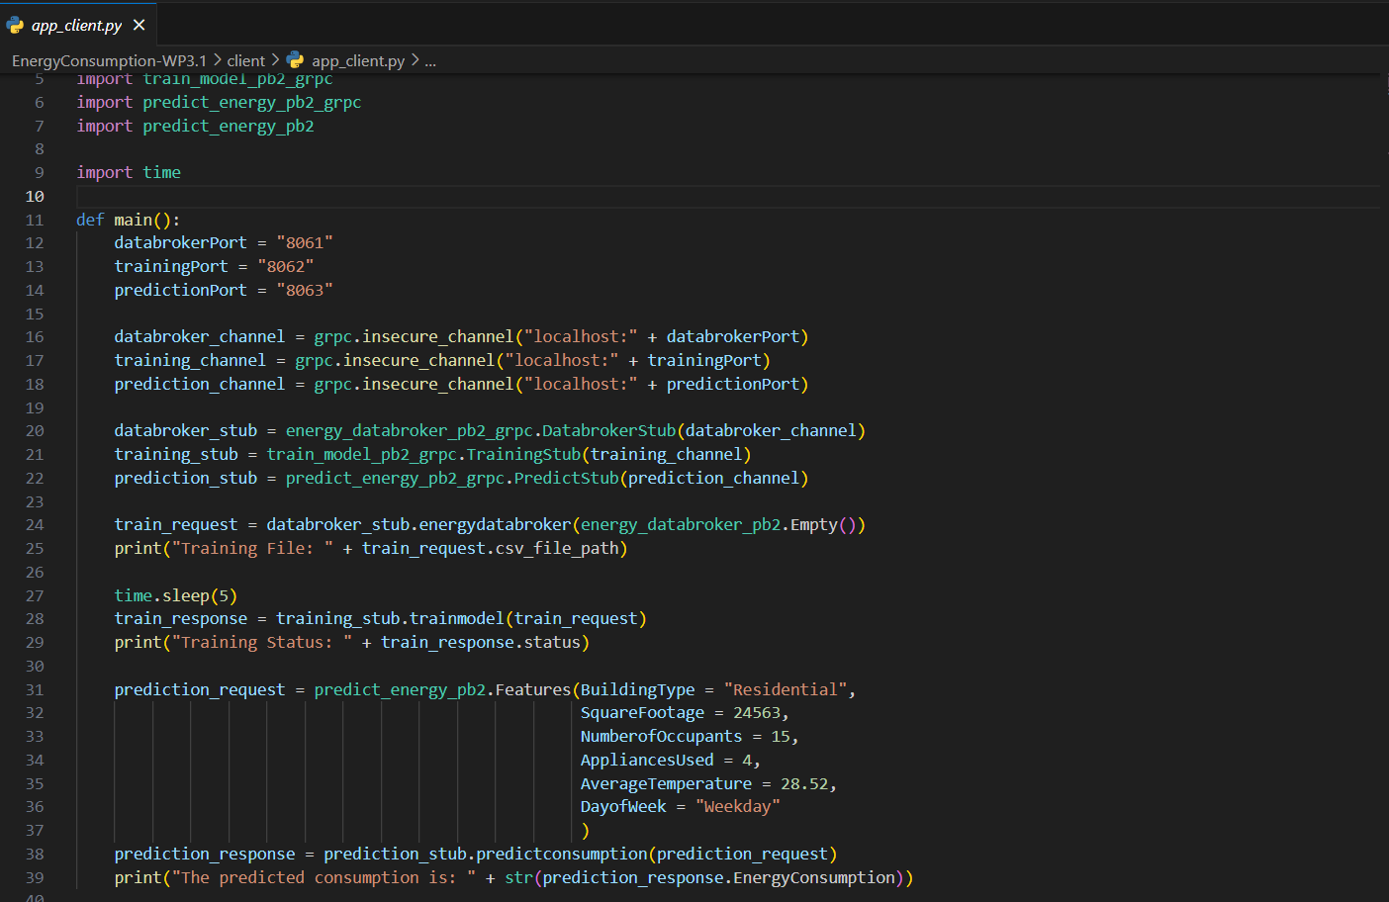
Developing the Model

Slide 11
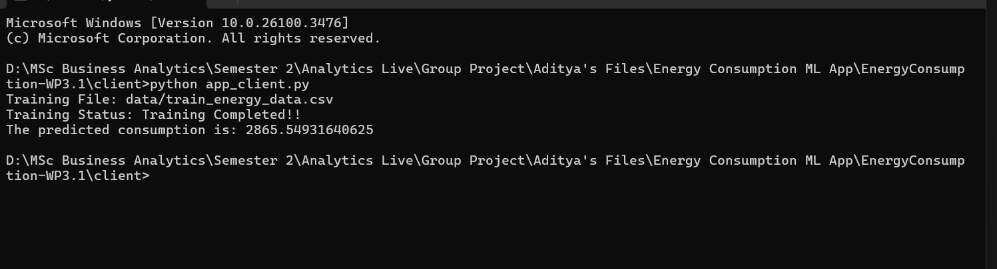
Developing the Model

Slide 12

Next Steps
Create Docker Images for the Databroker, Training, Prediction and Client Services.
Upload each generated service image to the docker repository.
Use the AI4EXP portal to create the prediction model pipeline and run it locally using Kubernetes.
After successful designer integration, pass the solution.zip from AI4EXP portal to WP3.2 group.

Slide 13
THANK YOU

